Slide 1
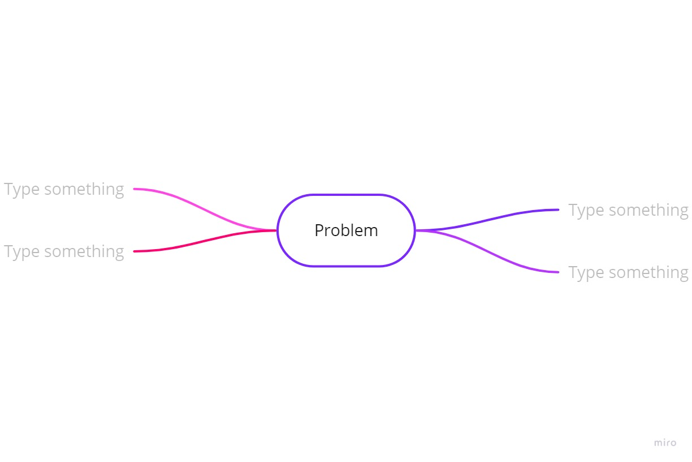
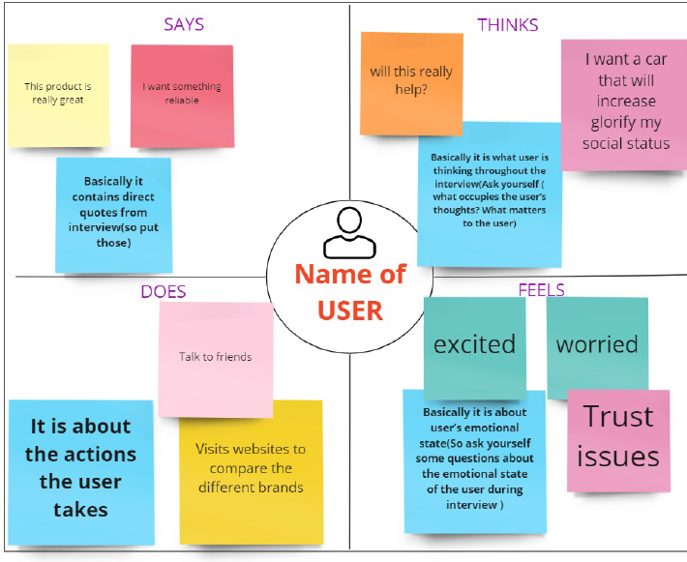
Introduction
Objective
Mind Map
2W1H model: it should answer 3 things What, Why and how (Include social relevance)
3W model: It should answer When, Where and Who (Include environmental relevance and cost)
Primary Research
Empathy Map
Primary research will cover the interview process
Identify the end user.
List down the age group, profession and gender of the end user.
Questions for interview.
Needs
Finalize 3 important Needs
Need1
Need2
Need3
Pain points
.
List down the very specific problems that your end users are experiencing.
Ideation
Final Problem Statement
 | Desirability | Viability | Feasibility
Problem Statement 1
Problem Statement 2
Problem Statement 3
Triz Principle
Out of 40 which inventive principle is applicable and how
Conclusion

